Slide 1
Holidays and COVID-19
Allen Lang (al8he)
CS 4774 Final Project Presentation
12/8/2020

Slide 2

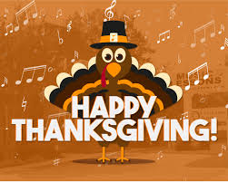

Motivation
Holiday season approaches
Time of frequent travel/gatherings
Determine effect of holiday travel/festivities on COVID-19 cases

Slide 3
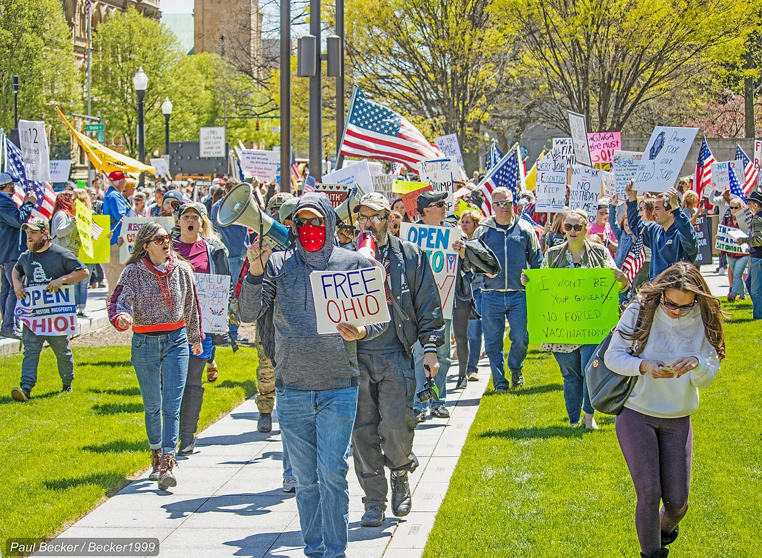
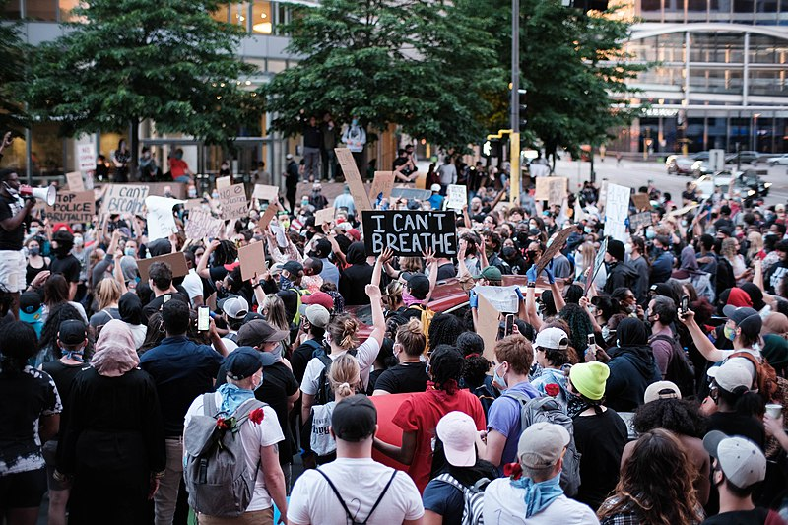
Background: Pandemic in US
Implemented quarantine measures in response to COVID-19
Heated debate in US about “re-openings”
Studies show COVID-19 spreads faster indoors rather than outdoors
Concerns about winter time and the holiday season
Lockdown protests opposing COVID-19 restrictions began in mid-April as people grew weary of polices that they felt were unnecessary.
George Floyd incident sparked nationwide protests, pushing BLM back to the forefront of news. Protests began late-May/early-June.

Slide 4
Background: Forecasting
High demand in many sectors
Economics and finance
Weather and geosystems
Low supply of quality forecasting
Lack of experts
Difficult to tune/understand models
Contemporary methods: ARIMA, ETS

Slide 5

Background: Prophet
“We are, in effect, framing the forecasting problem as a curve-fitting exercise” – Taylor and Letham
Facebook Core Data Science Team Python module
Simplification of time-series statistical analysis
$$y\left(t\right)=g\left(t\right)+s\left(t\right)+h\left(t\right)+ε_{t}$$
Trend
Non-periodic changes
Logistic or linear
Change points
Seasonality
Daily, weekly, monthly, yearly, etc.
Fourier Series
Holiday and Events
Common, predictable shocks without periodicity
Custom or built-in holidays by country
Error term
Assumed to be normally distributed

Slide 6
Related Work
COVID-19 forecasting
Compilation of models from various groups
Compartmental model of infectious diseases
Accounting for human factors
Prophet forecasting
Wikipedia web page visits
Stock price predictions
Biking usage rates

Slide 7
Target Task
Claim: holidays/special events lead to greater increase in COVID-19
Identify patterns/trends in COVID-19 statistics during and after a holiday period

Slide 8
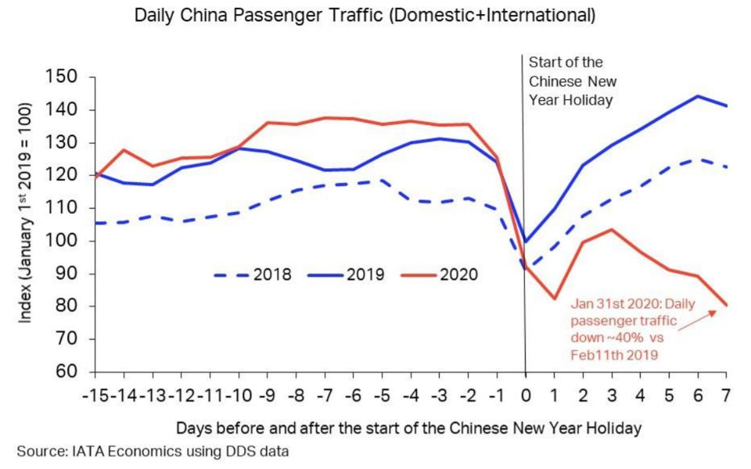
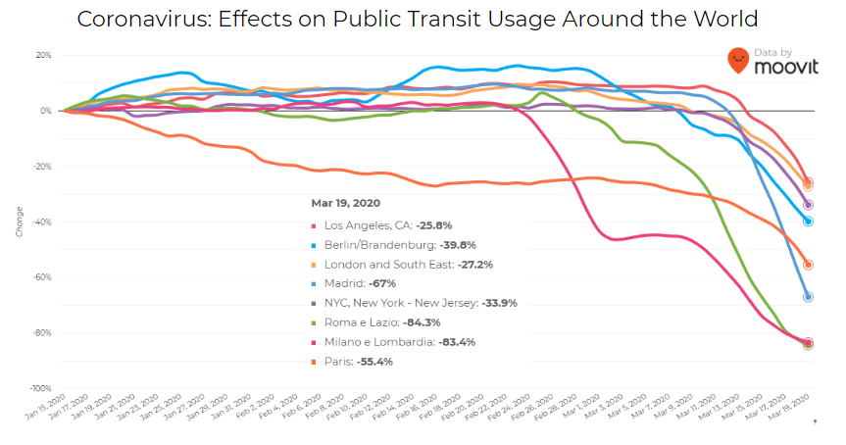
Intuitive Figure
Effect of COVID pandemic on daily movement in China
Effect of COVID pandemic on daily movement across different cities

Slide 9
Proposed Solution and Contribution
Construct Prophet time-series model
Fine tune model with hyperparameters
Introduce outside data sets
Build/Tune model that accounts for holidays and special events when forecasting COVID-19 cases
Better understanding of movements during pandemic, holidays, and holidays during pandemic

Slide 10
Implementation
Cleaning of Data with Numpy/Pandas
Construction of baseline model with Prophet
Hyperparameter tuning, figures with Plotly
Seasonality/Trends
Holidays
External regressors
Prediction forecast

Slide 11
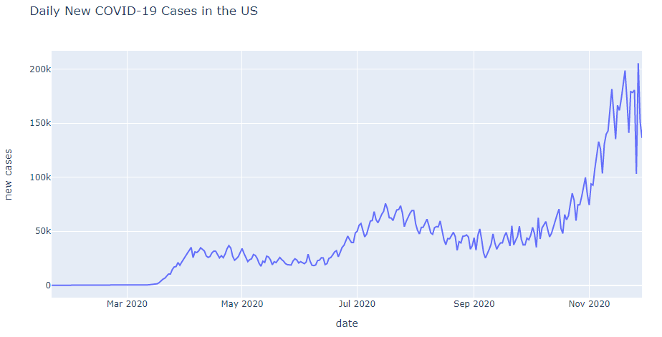
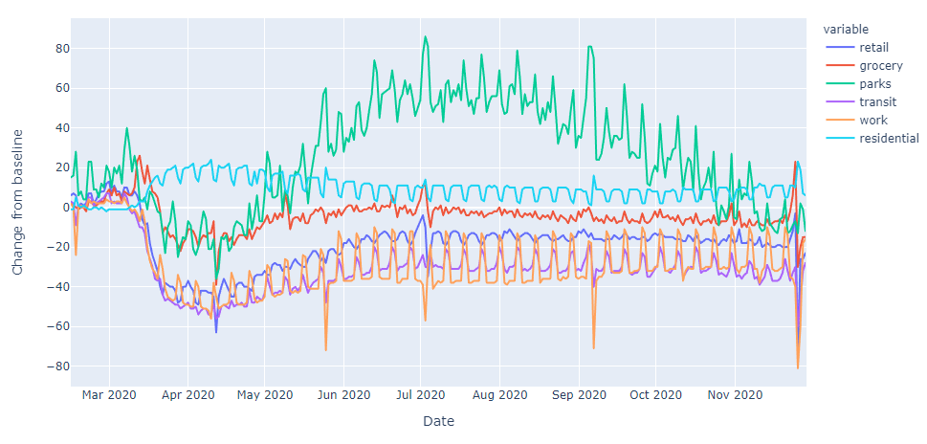
Data Summary
New York Times COVID-19 cases/deaths
National holidays across the world
Stringency index of national governments
Google Mobility Reports
Daily new cases of COVID-19 in the United States.
https://www.kaggle.com/paultimothymooney/nytimes-covid19-data
https://github.com/dr-prodigy/python-holidays
https://www.bsg.ox.ac.uk/research/research-projects/coronavirus-government-response-tracker
https://www.google.com/covid19/mobility/
Google Mobility data during the COVID-19 pandemic.

Slide 12
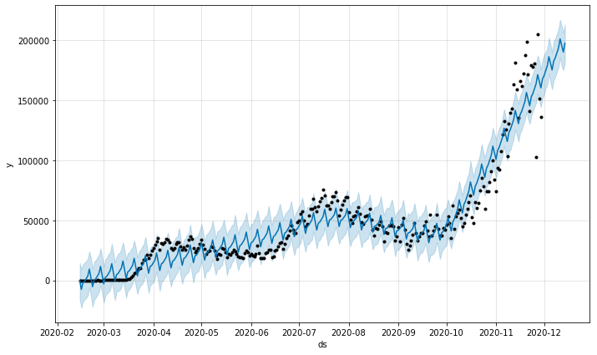
Results/Analysis: Baseline
Prophet model with COVID-19 new case data
February 15th to November 29th
Train RMSE: 11186.34
Test RMSE: 73059.23
Forecasted model with no parameters

Slide 13
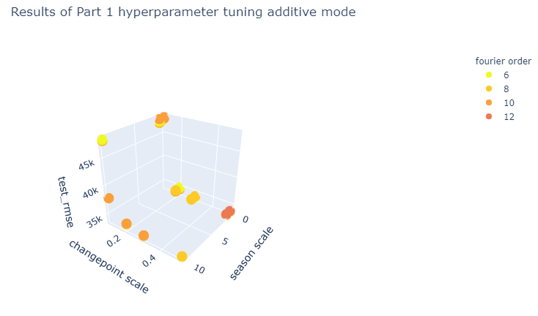

Results/Analysis: Tuning without Holidays
Seasonality: type of seasonality
Seasonality scale: flexibility of seasonality
Changepoint scale: flexibility of trend between changepoints
Fourier order: order of the Fourier series used for seasonality
Result of hyperparameter tuning for additive mode during part 1.
Hyperparameter grid for part 1

Slide 14
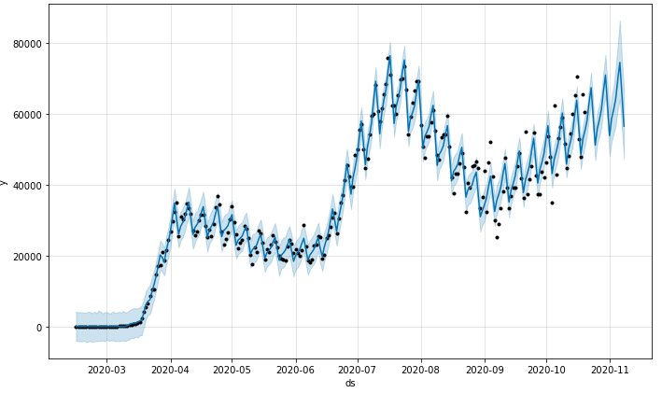
Results/Analysis: Tuning without Holidays
Best parameters:
Seasonality: multiplicative
Seasonality scale: 10
Changepoint scale: 0.5
Fourier order: 12
RMSE:
Train: 3171.63
Test: 32726.62
Forecasted model using best parameters for part 1.

Slide 15
Results/Analysis: Tuning with Holidays
Lower window: how far the holiday goes backward
Upper window: how far the holiday goes forward
Priority Scale: importance of each holiday as a "shock" to model

Slide 16
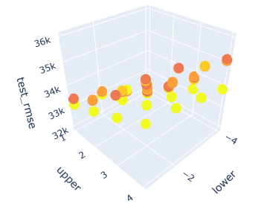

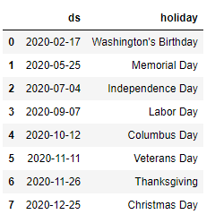

Results/Analysis: Tuning with Holidays
Part 2: Tuning with only generated holidays
Results of hyperparameter tuning for part 2
Hyperparameter grid for part 2 and 3
Holidays used in part 2.

Slide 17
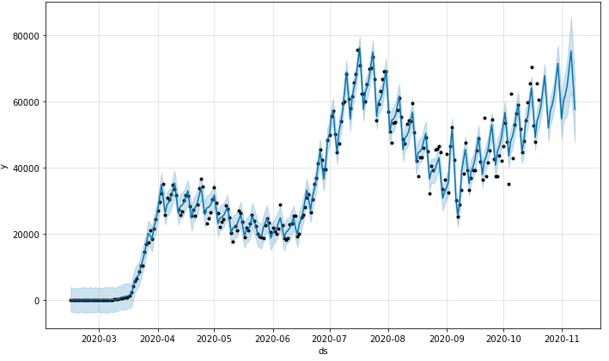
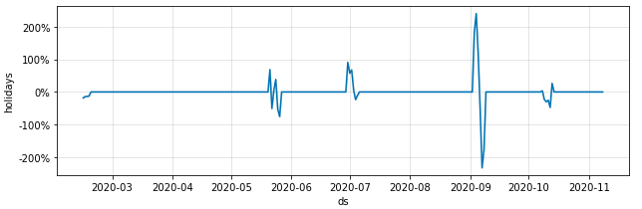
Results/Analysis: Tuning with Holidays
Best parameters:
Lower window: -4
Upper window: 1
Holiday Prior Scale: 5
RMSE:
Train: 2886.28
Test: 32057.55
Forecasted model using best parameters for part 2.
Holidays influence on forecasting for part 2.

Slide 18
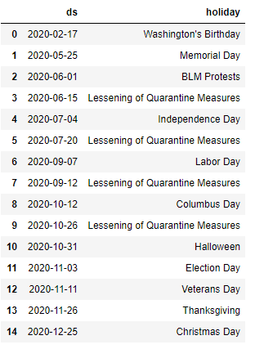
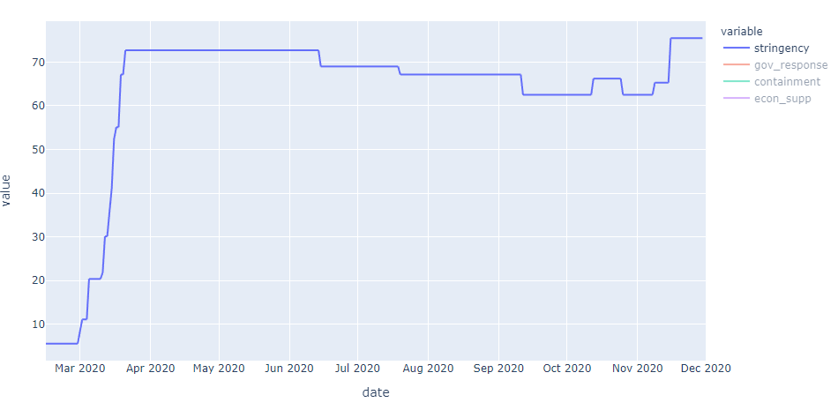
Results/Analysis: Tuning with Holidays
Part 3: Tuning with addition of special events
Holidays used in part 3.
Stringency index for the US over the pandemic. Lessening of measures highlighted in red.

Slide 19
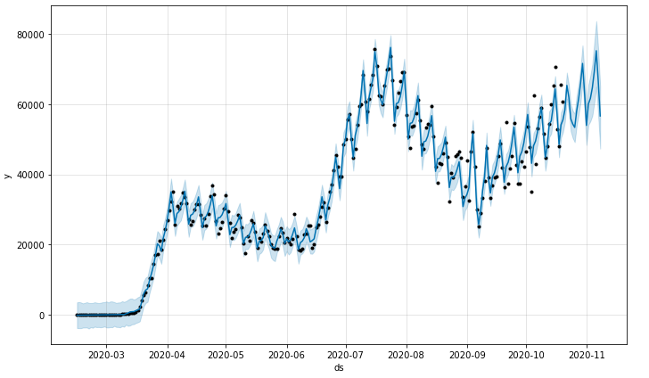
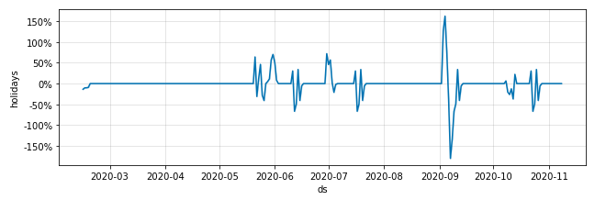
Results/Analysis: Tuning with Holidays
Best parameters:
Lower window: -4
Upper window: 1
Holiday Prior Scale: 10
RMSE:
Train: 2786.01
Test: 32712.98
Forecasted model using best parameters for part 3.
Holidays influence on forecasting for part 3.

Slide 20

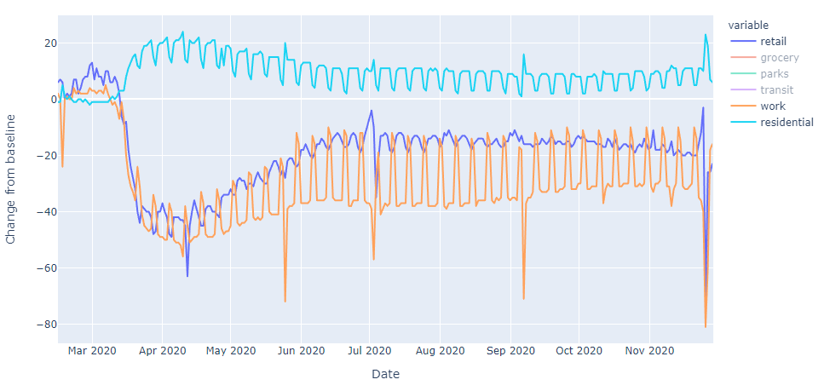
Results/Analysis: Tuning with Regressors
Best regressors:
Residential: multiplicative, 5
Work: multiplicative, 1
Retail: multiplicative, 1
RMSE:
Train: 2850.94
Test: 30731.03
Forecasted model using best parameters for part 5.
Retail, work, and residential mobility trends

Slide 21
Results/Analysis: Tuning summary
Results of hyperparameter tuning
Tuning Stage | Train RMSE | Test RMSE
Part 1: Without holidays | 3171.63 | 32726.62
Part 2: With holidays | 2886.28 | 32057.55
Part 3: With holidays/events | 2786.01 | 32712.98
Part 4: With holidays/events manual | 3024.23 | 32700.53
Part 5: With regressors | 2850.94 | 30731.03

Slide 22
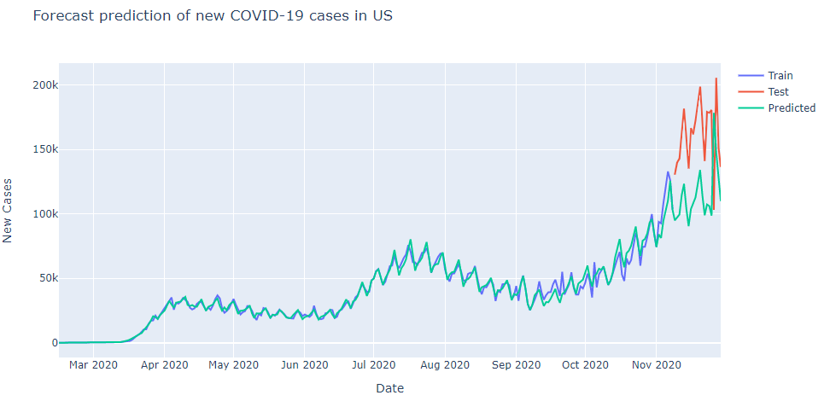
Results/Analysis: Prediction
Baseline:
Train RMSE: 11186.34
Test RMSE: 73059.23
Final model:
Train RMSE: 4137.23
Test RMSE: 56454.53
Predicted forecast model with tuned model.

Slide 23
Conclusion: Observations
Inclusion of national holidays improved model performance
Stark contrast between lower and upper window parameters
Positive response to other time-series data

Slide 24
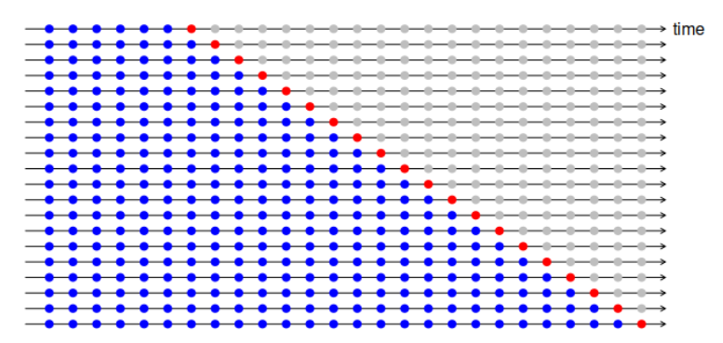
Future Work: Extensions within Prophet
Metrics: looking into percent-error based
Tuning methods: Prophet’s built-in cross validation
Holidays: precise way to optimizing each holiday’s parameters
Regressors: other time-series data like temperature
Graphic explaining cross validation for a time series

Slide 25
Future Work: Extensions outside Prophet
Benchmarking: comparison with other methods
Classical statistical methods
ARIMA
ETS
Holt-Winters
Neural networks
LSTM, RNN
MLP

Slide 26
Thank You!
Professor Qi, Zhe, Jack, Arshdeep

Slide 27
References
https://commons.wikimedia.org/wiki/File:CIMG_0355_(49799414598).jpg
https://en.wikipedia.org/wiki/File:Minneapolis_05-28-20_(49947863357).jpg
https://facebook.github.io/prophet/
https://www.cdc.gov/coronavirus/2019-ncov/covid-data/forecasting-us.html
https://covid19-projections.com/
https://nbviewer.jupyter.org/github/nicolasfauchereau/Auckland_Cycling/blob/master/notebooks/Auckland_cycling_and_weather.ipynb
https://www.kaggle.com/paultimothymooney/nytimes-covid19-data
https://github.com/dr-prodigy/python-holidays
https://www.bsg.ox.ac.uk/research/research-projects/coronavirus-government-response-tracker
https://www.google.com/covid19/mobility/
https://journals.plos.org/plosone/article?id=10.1371/journal.pone.0194889

